Slide 1
CENTRE FOR LANGUAGE STUDIES (AY2026-27 SEMESTER 1)
KOREAN LANGUAGE PLACEMENT TEST
GUIDELINES & CAUTIONS
      Students with prior knowledge of the Korean language MUST take the placement test.
      Any student meeting the criteria for "Prior Knowledge" is obligated to sit for the placement test, regardless of whether they have already successfully registered for the course.
      Students who enroll in the course without following the proper placement test will face compulsory administrative withdrawal by the centre authorities, and may face penalities or receive an “F” grade without prior notice. The Centre for Language Studies reserves the right to withdraw students from both the class and the course, applying appropriate penalties (“W” or “F” grades).
      Students must ensure that there are no scheduling conflicts with their core courses before taking the test.
      Students are strongly encouraged to review the textbooks, “All-in-One KOREAN (Basic)” and “Yonsei Korean in 3 weeks” available at the Central Library. This will help them learn the materials covered in NUS Korean language programme and prepare for a level-appropriate test.
      To successfully register for the course, students must complete all three steps: 1) Survey → 2) Written Test & oral test registration → 3) Oral Test. Failure to complete these steps will result in a “No Module” status, preventing course registration.
      The placement test result is valid for ONE SEMESTER ONLY.
Prior knowledge includes, but is not limited to: - Formal Learning: Any experience of learning Korean at community centres, private schools, or through private tuition. - Self-instruction: Any self‐study using books or internet resources. - Informal Exposure: Any exposure to Korean, whether regular or irregular, from family members or friends. - Basic Literacy: Any student capable of reading Hangeul (the Korean alphabet) must take a placement test first.

Slide 2
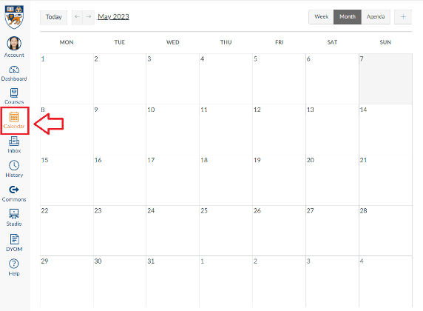

[Korean Language Programme] Placement Test
Survey Form | 15 July (Wed.) – 22 July (Wed.)
 | Survey form (Click here) ① Please click the link and fill out the survey form by 4 PM on 22 July. ② Students will receive CANVAS link by email on 8 July/22 July.
1
Written Test & Oral Test Registration | 23 July (Thu.) – 27 July (Mon.)
 | CANVAS Course (LAK0000 / [Korean] Placement Test) ① Students are required to take the written test during the specified period. (LAK0000 > Quizzes) ② Students are allowed to take two or more written test of different levels simultaneously. ③ Students are required to register for their oral test time slot on CANVAS (CANVAS > Calendar on the left side menu > Find appointment) by 4 PM.
2
3
Oral Test | 29 July (Wed.)
 | Time Slot & Zoom Link: TBA Students will have a 1-on-1 interview for less than 10 minutes.
4
Test Result | 31 July (Fri.)
 | Results will be released after 2 PM on CLS homepage.
Schedule can be subject to change.

Slide 3
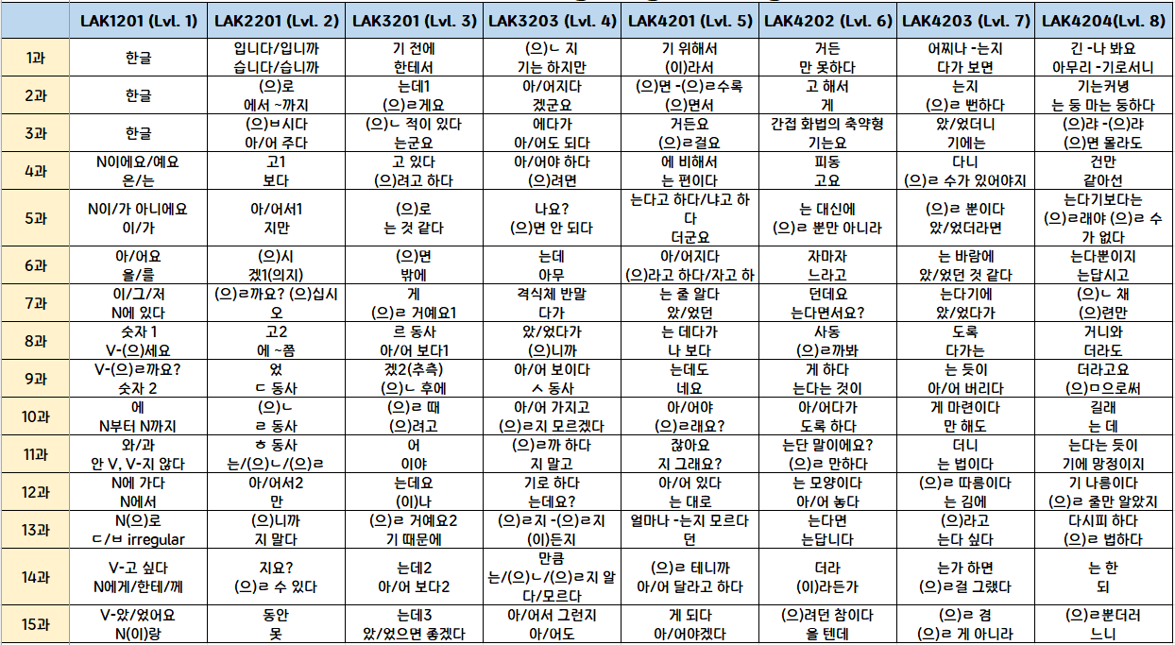
NUS KOREAN LANGUAGE PROGRAMME
Textbook (Level 1) : “All-in-One KOREAN (Basic)”
Textbook (Level 2-8): “Yonsei Korean in 3 weeks”

