Slide 1
A Neglected World: The Role of Services in Trade and Global Production Networks
GPN@NUS
Singapore
26 January 2015
Patrick Low
Fung Global Institute

Slide 2
Overview
Services in th eglobal economy
Measuring trade in terms of value-added
How services contribute to value
Case study: The journey of a loaf of bread

Slide 3
Services in the Global Economy

Slide 4


              Evolving perceptions
Why a history of neglect?
‘The labour of a menial servant…adds to the value of nothing…services generally perish in the very instant of their performance, and seldom leave any trace or value behind’ Adam Smith (1776)
1960s: The Baumol Cost Disease: services the poor cousin, bereft of productivity growth
What is changing?
A broader view of the range of services, along with technology, globalisation, process innovation
A missing link: measuring trade as value-added
Asian Perspectives Global Issues

Slide 5
Why have services been neglected?
The relative neglect of services
Historical factors
Mind sets
Invisibility
Many services embedded in goods
Customiz-ation
Lack of reliable data
Asian Perspectives Global Issues

Slide 6
The growing prominence of services
Services account on average for around 70% of production
Services may account for a similar share of trade (when measured correctly)

Slide 7
Value-Added: What Are We Measuring?
  Trade measured in terms of flows in value-added is to be contrasted with gross trade flows
The value-added calculation captures what happens at each stage in a production process
It tracks inputs into the production process all the way down the line until the final product emerges
Asian Perspectives Global Issues

Slide 8
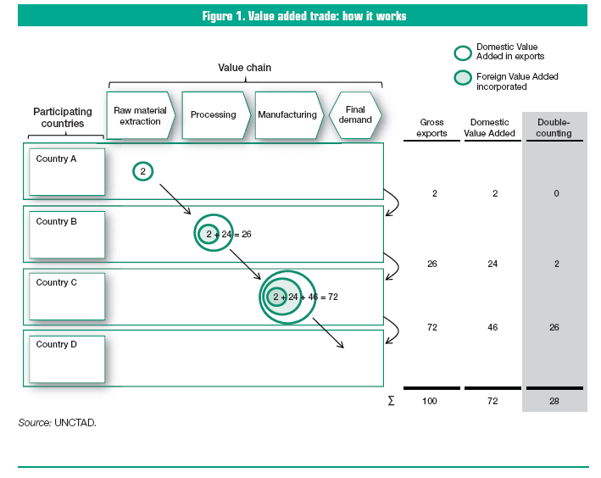
How does value-added measurement of trade work?
Asian Perspectives Global

Slide 9
Value-Added Trade Data
The import content of trade is rising globally (some two-thirds of merchandise imports are intermediate goods)
Single products are produced in multiple countries
The last country of production is but a link in the chain, one among several contributions to value-added
This has profound implications for how we think about trade and interdependency
It carries significant policy implications
Asian Perspectives Global Issues

Slide 10
Value-added measurement reveals more about trade
Value-added
Structure
Technology Content
Inter-dependence
Competition
Policy Interface
Employment
Environment

Slide 11

An iPhone “Exported” From China to the USA
Total price: US$178.96
Recorded in USA as import from China
Real Chinese value exported: US$2.20
Components and labour:
Source: Xing, Y and N. Detert, ADBI Working Paper 257 (2010),
Asian Perspectives Global Issues

Slide 12







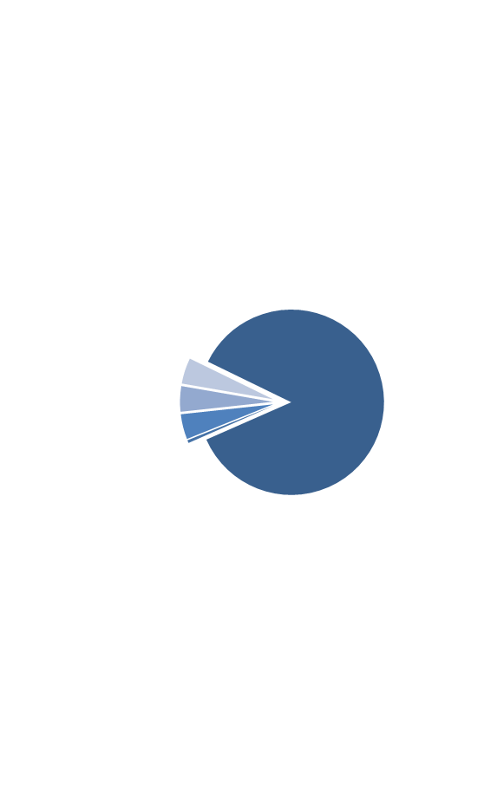
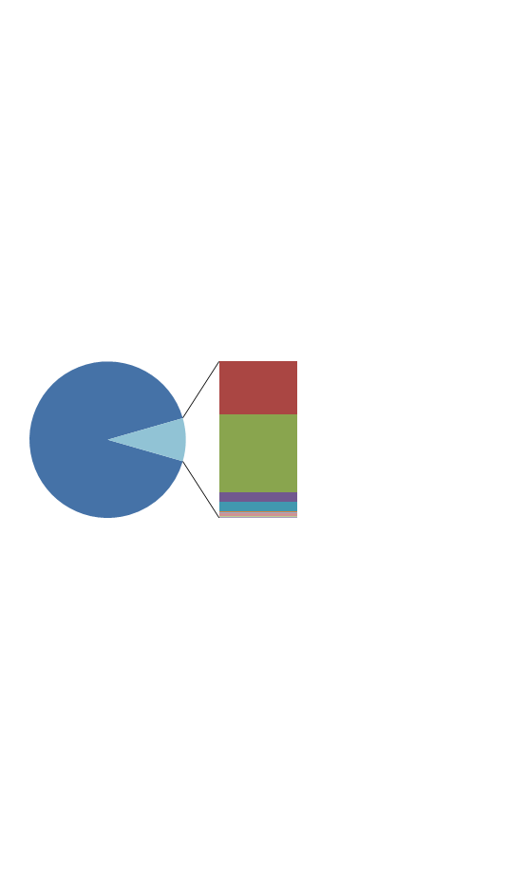
Case Study: A suit made in China and sold in the US
$425
Cost Breakdown by Country
Manufacturing Costs and Invisible Assets
86%
Manufacturing
5%
9%
4%
91%
4%
Invisible Assets
1%
Services (retail, logistics, banking, etc.)
Intellectual Property
Profits
Other Unknowns
Source: Fung Global Institute Li & Fung case study

Slide 13
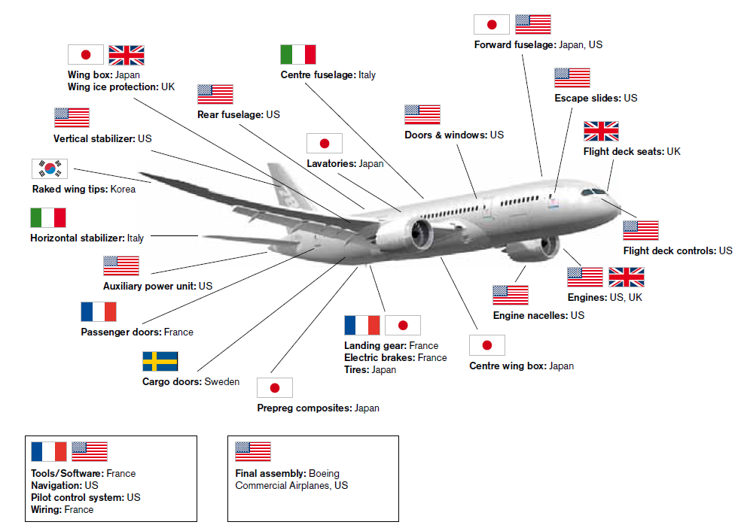
Boeing 787 Dreamliner
Made in the world
Source: Meng & Miroudot, OECD
Notes:
Another breakdown of a good’s components by origin and destination, i.e. country of origin and last known destination in merchandise trade statistics.

Slide 14
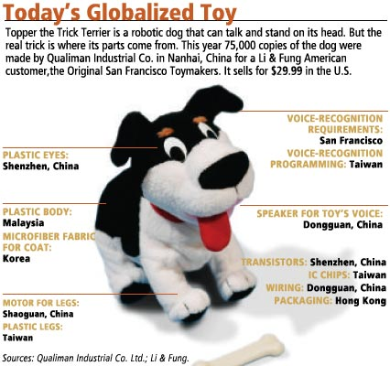

Slide 15
Sectoral contribution to total trade, gross and value-added measures (2008)
(Source: WTO Secretariat estimates based on OECD-WTO data)

Slide 16
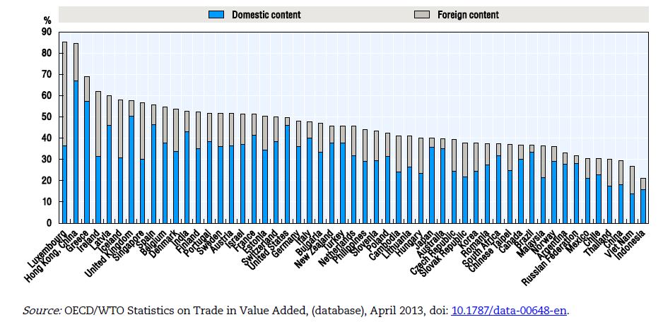
The share of services in total value added in exports

Slide 17
The Role of Services in Value Chains

Slide 18
Overview
The role of services in GVCs
Limited
knowledge of
the role of
Intangibles
along supply
chains
Growing
prominence of
services –
“servicification”
Trade in
tasks and
services –
more than
just a
nomenclature
challenge
Services as a
source of
innovation –
mostly process
innovation
Bundling
Outsourcing
Asian Perspectives Global Issues

Slide 19
Servicification: what is it?
Services are becoming increasingly important in all economies
On the consumption side
Typically services consumption rises with income levels
Services offer more variety and product choice than goods
On the production side
Globalization, or the internationalized economy, has increased demand for services, especially along GVCs
As output expands, there is more than proportionate demand across every activity in the economy for certain kinds of services – telecoms, ICT, finance, insurance, energy, transport etc.
Services are more customized than goods
Asian Perspectives Global Issues

Slide 20
Bundling
Definition
Bundling is when different goods and/or services are combined in a single product offering
Where is bundling?
Bundling is quite frequently seen in outsourced offerings, and at the beginning and end of whatever GVC is being examined
Functions of bundling
Differentiate products and accrue more value addition
Facilitate cost-minimizing mixes where scale of component supply a factor
Confer tradability on otherwise non-tradable services
Innovation and bundling may well go together
Asian Perspectives Global Issues

Slide 21
Outsourcing
How frequent is outsourcing on GVCs?
Some reasons for outsourcing
Standard cost (competitiveness) considerations
Some reasons for not outsourcing (not always cost-driven)
Protection of proprietary information, pivotal pieces of the GVC
Not just a matter of cost minimisation—cost and efficiency not always the same thing
External scale advantages – various forms of networks, networking associated with skill sets (e,g, security services, recruitment, customs agents)
Some internal economy of scale considerations (e.g. fixed costs, market size, and desire to maintain market share or product variety)
Other risk management factors
Asian Perspectives Global Issues

Slide 22
Policy and Services in GVCs
Policy intervention on goods vs. policy intervention on services
Goods
Lower levels of protection
Less intense intervention
Services
Mostly regulations
Higher levels of protection
More intense intervention
Because production is international and intermediate products cross frontiers several times, policies have a multiplicative effect on production costs
Asian Perspectives Global Issues

Slide 23
Policy as added value, subtracted value and innovation
Policy Interventions
Policy as innovation
Efficiency through:
- openness
- streamlining
- learning
- best practice
- governance
Policy as added value
Policy as subtracted value
Solutions
Efficient public policy:
- health
- safety
- environment etc.
Protectionism:
discriminatory taxes
- exclusions
- regulations
- others
Deadweight losses:
- procedures
- inefficiencies
- under-investment
- corruption
Less
growth…. Development.. ………jobs
Asian Perspectives Global Issues

Slide 24
Case Study: Bread Value Chain

Slide 25

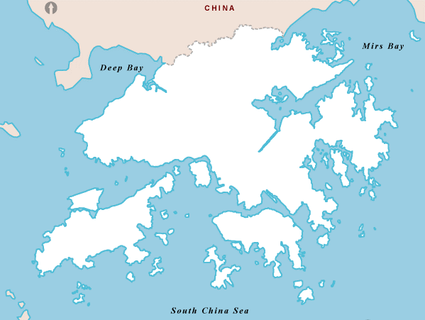



Case Study – Bread Value Chain
2. Manufacturing Plant in industrial park in Shenzhen
1. Ingredients procured in China
3. Cross-border transport for bread
1. Port in Shenzhen
1. Imported Ingredients from South Korea (sugar), Taiwan (margarine) and Australia (salted butter)
4. Warehouse in Kowloon, Hong Kong
5. Local delivery from warehouse to over 90 retail outlets
Source: Fung Global Institute. Outline map of Hong Kong from www.mapsopensource.com

Slide 26
Case Study – Bread Value Chain
Key findings
30
Number of different services identified in the value chain
72%
Value of the product contributed by services
18 out of 30
Proportion of the services partially or fully outsourced to external suppliers

Slide 27
Case Study – Bread Value Chain
Examples of policy interface
Policy | Value addition | Cost addition
Food safety standards | Improved reputation of China’s food exports Easy tracking of food sources in case of food safety issues | Complicated standards are subject to local officials’ interpretation Heavy administrative burden of compliance
Environmental policies (e.g. carbon trading, wastewater discharge) | Better air quality. environmental hygiene and water safety Induced process innovation to improve energy efficiency | Energy audit services required
Customs regulations | Ensures accurate calculation and collection of import duties, VAT, etc. | Specialized customs services agents are required

